Slide 1
CSE712 Midterm Presentation
21166033 Rafeed Rahman
21366016 Riyo Hayat Khan
21366021 Dibyo Fabian Dofadar
21366035 Md. Sabbir Ahmed
2352574989 Sajib Kumar Saha Joy
Presented by
Group 4

Slide 2
Emotion Recognition under Consideration of the Emotion Component Process Model
Felix Casel, Amelie Heindl, and Roman Klinger

Slide 3
Abstract & Introduction By Riyo Hayat Khan

Slide 4
Abstract
Emotion classification in text
Performed with neural network models
Good predictive performances, but limited understanding on how emotions are communicated in various domains
Emotion component process model (CPM) by Scherer (2005)
Explains emotion communication
Emotions are a coordinated process of subcomponents
The authors have
Hypothesized that these components are linked to linguistic realizations
Included the CPM in a multitask learning model and found that this supports the emotion categorization

Slide 5
Introduction
Communication of emotions in text follow the five subsystems of CPM
Explicit mention of the emotion name (“I am angry”)
Focusing on the motivational aspect (“He wanted to run away.”)
Describing the expression (“She smiled.”, “He shouted.”)
Physiological bodily reaction (“she was trembling”, “a tear was running down his face”), the subjective feeling (“I felt so bad.”)
Describing a cognitive appraisal (“I wasn’t sure what was happening.”, “I am not responsible.”)

Slide 6
Introduction (Continued)
Study of how emotions are communicated following the component model
In Tweets (Twitter Emotion Corpus TEC)
In Literature (REMAN corpus)
Research goals
To understand if emotion components are distributed similarly across emotion categories and domains
To evaluate if informing an emotion classifier about emotion components improves their performance (and to evaluate various classification approaches).

Slide 7
Background and Related Work By Md. Sabbir Ahmed

Slide 8
Emotion Models
Ekman considered anger, disgust, fear, joy, sadness and surprise as basic emotions
Nine characteristics of a basic emotion such as distinctive universal signals, distinctive physiology, coherence among emotional response
Plutchik proposed a model with eight main emotions
Dimensional affect model corresponds to a 3-dimensional vector space

Slide 9
Emotion Models (Continued)
The five components of Appraisals model proposed by Scherer
Cognitive appraisal
Neurophysiological bodily symptoms
Motor expressions
Motivational action tendencies
Subjective feelings
Infer the emotion experienced by a person by analyzing the set of changes in the five components

Slide 10
Emotion Analysis in Text
The majority of modelling approaches focuses on the analysis of fundamental emotions
Work with a focus on other aspects of emotions is rare
The work of Scherer and Wallbott focus on the existence in the described event
Holfmann and his team’s done a prediction of emotion categories based on the component of the CPM
Kim and Klinger analyze the emotions in fan fictions

Slide 11
Corpus Annotation By Dibyo Fabian Dofadar

Slide 12
Corpus Selection
REMAN Corpus:
Out of 1720 instances, 1000 were were taken randomly
Each instance comprises of several annotated spans
These emotion spans were annotated based on anger, fear, trust, disgust, joy, sadness, surprise, anticipation and others
Twitter Emotion Corpus (TEC):
Consists of 21,000 Twitter posts where 2041 instances were sampled
Emotions like anger, disgust, fear, joy, sadness and surprise are present in the hashtag of the twitter posts
Each instance equals one post and has exactly one emotion label

Slide 13
Annotation Procedure & Inter-Annotator Agreement
Procedure
Emotion component dimensions were annotated independently
The existence of a CPM label means this component is mentioned somewhere in the text
It ensures that no other information leak introduced during annotation
Guideline Refinement Process
Two annotators measured the inter-annotator agreement based on the assigned instances which helped refining the list of guidelines
During the measurement process, several rule and guidelines were newly added or modified
After the completion of refinement process, Annotator 1 and 2 annotated the subsample of TEC and REMAN respectively

Slide 14
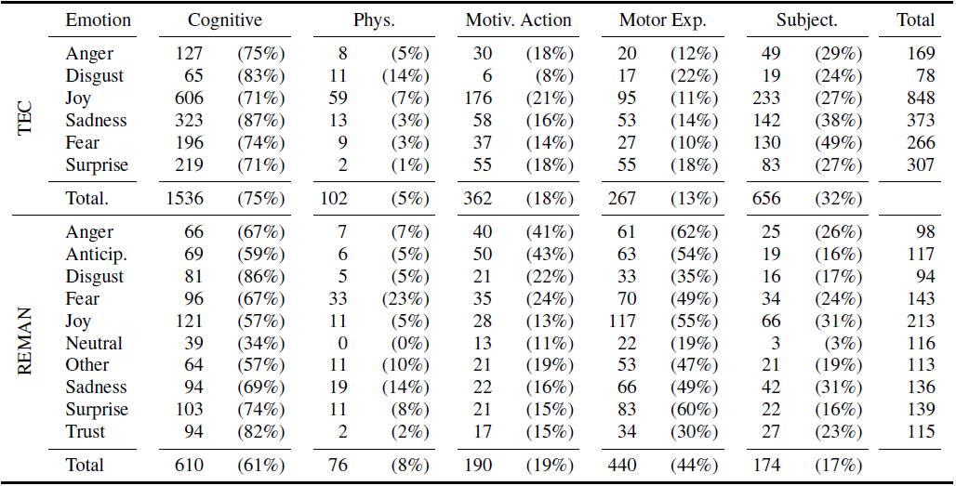
Corpus Statistics
Figure: Total/relative counts of CPM components and emotions

Slide 15
Methodology
By Sajib Kumar Saha Joy

Slide 16
Emotion Classifier:
Are not particularly informed about emotion components
Emo-ME-Base
As preprocessing, they convert all words to lowercase, and stem them with the PorterStemmer.
TF-IDF-weighted bag-of-words unigram and bigram features.
On TEC, with its single-label annotation, Emo-ME-Base consists of one model, while on REMAN with multi-label annotation, they use 10 binary classifiers.
Emo-NN-Base
Emo-NN-Base uses pre-trained BERT sentence embeddings as input features. The network architecture
consists of a bidirectional LSTM layer followed by a convolutional layer.
The outputs of the convolutional layer are max-pooled over the dimension of the input sequence,
On top of the pooling layer is a fully connected layer. Its outputs are finally fed into an output layer with a sigmoid activation function for making the prediction
Dropout is used after each layer to tackle overfitting.
Emo-Cpm-NN-Pred
Predict emotion by combining Emo-NN-Base model and Cpm-NN-Base model through fully connected layer.

Slide 17
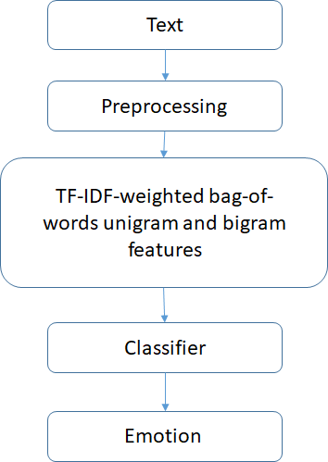
Figure: Emotion Classification Model Architecture (Emo-ME-Base)

Slide 18
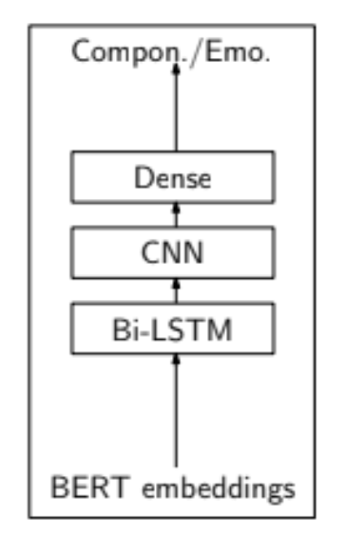
Figure: Emotion Classification Model Architecture (Emo-NN-Base). It can also be used to predict component

Slide 19
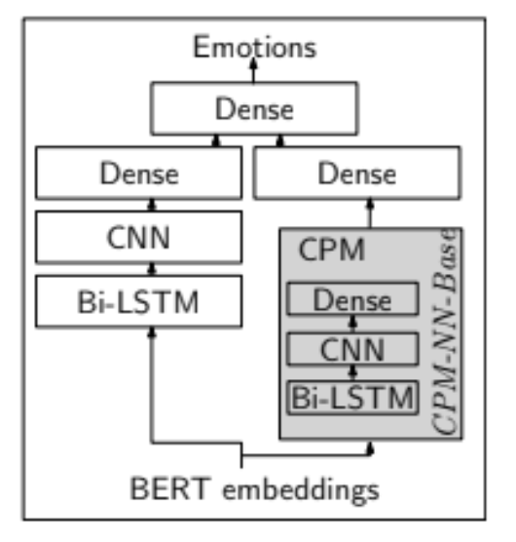
Figure: Emotion Classification Model Architecture (Emo-Cpm-NN-Pred)

Slide 20
Component Classifier:
The emotion component classifiers predict which of the five CPM components occur in a text instance.
Cpm-ME-Base
Cpm-ME-Base baseline models (one for each component) only use bag-of-words features in the same configuration as Emo-ME-Base.
Cpm-NN-Base
The Cpm-NN-Base is configured analogously to Emo-NN-Base.
Cpm-ME-Adv
Add task specific features, namely features derived from manually crafted small dictionaries with words associated with the different components.

Slide 21
Joint Modelling and Multi-Task Learning
of Emotions and Components:
Predicts emotion and its component at the same time
To analyze if emotion classification benefits from the component prediction.

Slide 22
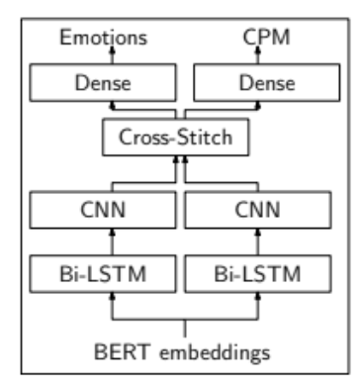
Figure: Joint multi tasking model for predicting emotion and its component at the same (MTL-XS)

Slide 23
Results & Conclusion
By Rafeed Rahman

Slide 24
For the experiment :
The authors used their annotate sub-samples of TEC and REMAN corpuses
They splitted the Corpora into 90% for training and used the remaining 10% for testing purpose

Slide 25
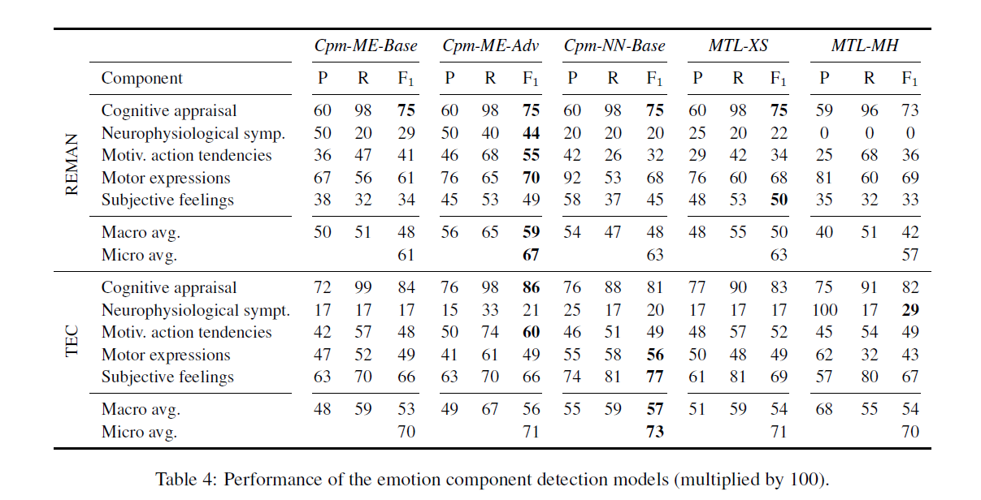
Component Prediction

Slide 26
As the author mentioned that this task has not been addressed before and their dataset is the first to be introduced into the community
Macro Average F1 scores on REMAN range from .42 of MTL-MH to .59 for Cpm-ME-Adv, and from .53 (Cpm-ME-Base) to .57 (Cpm-NN-Base) on TEC.
On REMAN, the feature-based model is superior which might be due to the engineered features being more commonly represented in the literature domain than in social media.
The inclusion of predicted component information as features in the neural network model shows no improvement on REMAN or on TEC.

Slide 27
The lowest performance scores are observed for neurophysiological symptoms. This holds across models and corpora.
For the neurophysiological component on the literature domain, however, the engineered features in Cpm-ME-Adv showed substantial improvement, yielding an F1 score of 0.44.

Slide 28
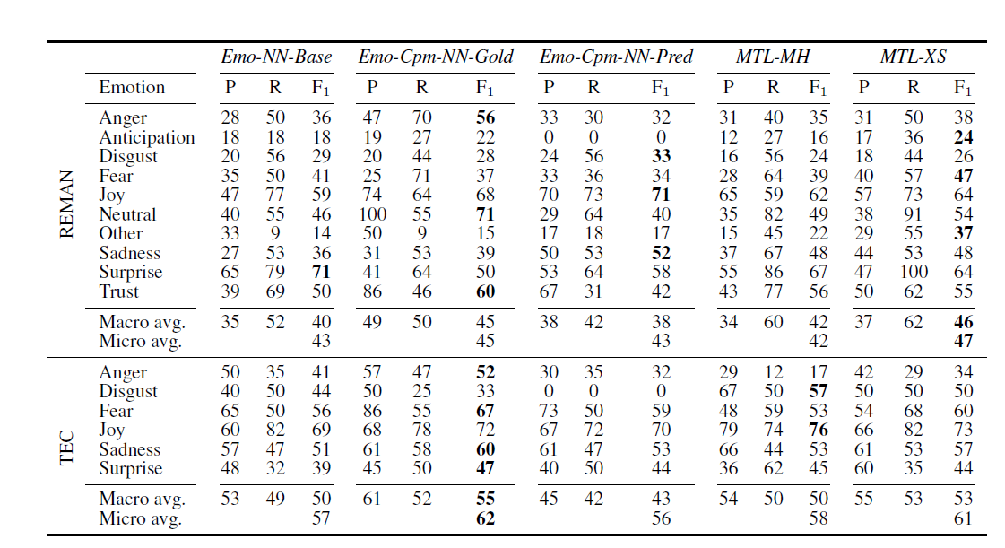
Emotion Classification

Slide 29
In this section, they discuss the performance of their emotion classification models across different configurations. One question is how providing component information to them helps most.
Their main research question is if emotion components help emotion classification.
In their first attempt to include this information as features, they saw some improvement.

Slide 30
Conclusion
The authors presented the first data sets (based on existing emotion corpora) with emotion component annotation
With this paper they moved to another psychological theory, namely the emotion component process model, and made the first annotations available that closely follow this theory.
They have shown that, even with a comparably limited data set size, emotion components contribute to emotion classification. They expect that with a larger corpus the improvement would be more substantial than it is already now.
They propose that future work analyzes further which information is relevant and should be shared across these tasks in multi-task learning models.
Further, they proposed that larger corpora should be created across more domains, and also that multitask learning is not only performed individually, but also across corpora.

Slide 31
Thank you

